Slide 1
Using Open APIs for a Virtual March
Presenters:
Tracey Conaty, AFSCME
Alan Gallauresi, Beaconfire

Slide 2

The Campaign
Act Now – Emergency Campaign for America’s Priorities
A nationwide campaign of national and grassroots organizations committed to reversing the Administration’s policy of drastic cuts to programs that primarily benefit the poor and middle class in order to finance tax cuts that benefit the wealthy and special interests. Our “First Things First” agenda is a plan to fully meet pressing human needs over five years and assure that all pay their fair share.

Slide 3
Project
Goals
  Expand definition of “virtual march” beyond simple online advocacy with sign-up forms
  Draw marchers in with an interactive application
  Give marchers a sense of “big picture” as well as “local” grass roots action
  Capture advocacy data for future campaigns

Slide 4
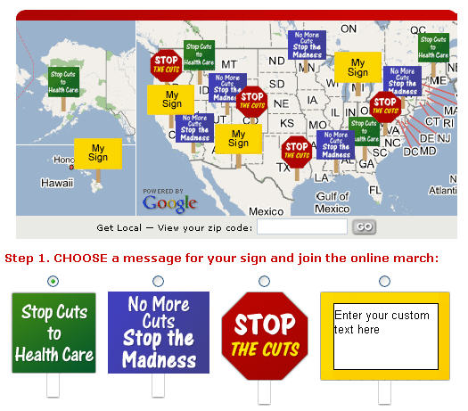
The national map shows a number of random signs to show the geographic breadth of the march and invite users to play with the application
Marchers can choose their sign and enter custom text in addition to their contact info

Slide 5
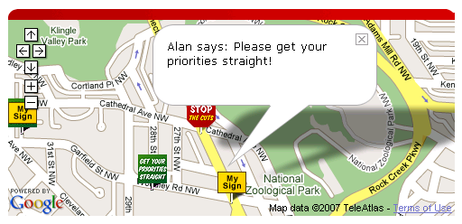
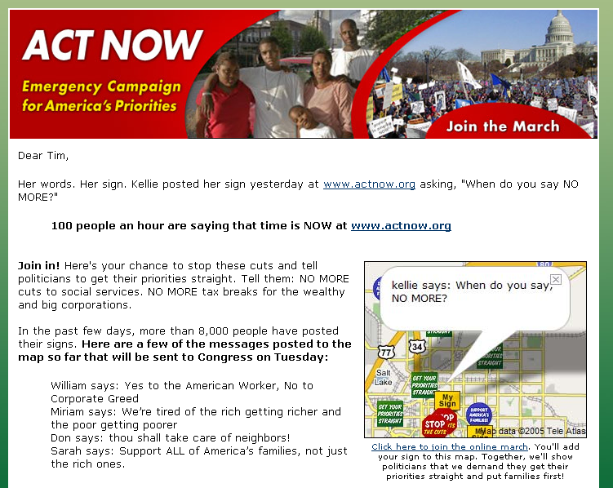
Case Study
A zoom-able and moveable personal map shows your local area and the marchers in your neighborhood
Tactics: Sustained Campaigning
“Locked” versions of the map appear on Tell-A-Friend pages to always show your personal message

Slide 6
Technical Details
PHP Fusebox-style application
MySQL database to store marcher data as well as zip code data
Several map views:
  National Map with random signs
  Local map centered around your zip-code
  Personal map with your sign expanded at your address
Email-a-friend mechanism to track most active marchers and reward them
Several integrations…

Slide 7
APIs & Integrations
Google Maps
  Provided map functionality
  Interface was JavaScript API with AJAX
Geocoder.us
  Provided geocoding (the translation of addresses to coordinates)
  Interface was SOAP or REST calls
GetActive
  Provided mechanism for adding marchers to advocacy centers
  Interface was HTTP form post to emulate user manually filling out campaign form.

Slide 8
Lessons Learned
Integrations step was easy – accommodating our changes was hard
Feature creep is hard to avoid with flashy tech
Performance issues with large numbers of Google markers

Slide 9
Marching Forward
Easier integrations:
  Simplified use (Google Maps now supports geocoding, JSON style data)
More options
  Google Maps vs Yahoo Maps vs MapQuest
More integrations:
  Flickr - Let people add their photo to the sign, tag them to create community, create codeless views into march.
  Blogs (Wordpress, Blogger, etc) - Automatically post milestones (“5,000 marchers”, “Marcher in every state”

